Slide 1
EVOLUTION OF AIRCRAFT IN WARFARE FROM WORLD WAR ONE THROUGH TODAY

Slide 2
Introduction
Early uses of aircraft; pre-World War One
Changes in aircraft through the war
Role of the airplane in war
Aircraft and airman evolution
Future?

Slide 3
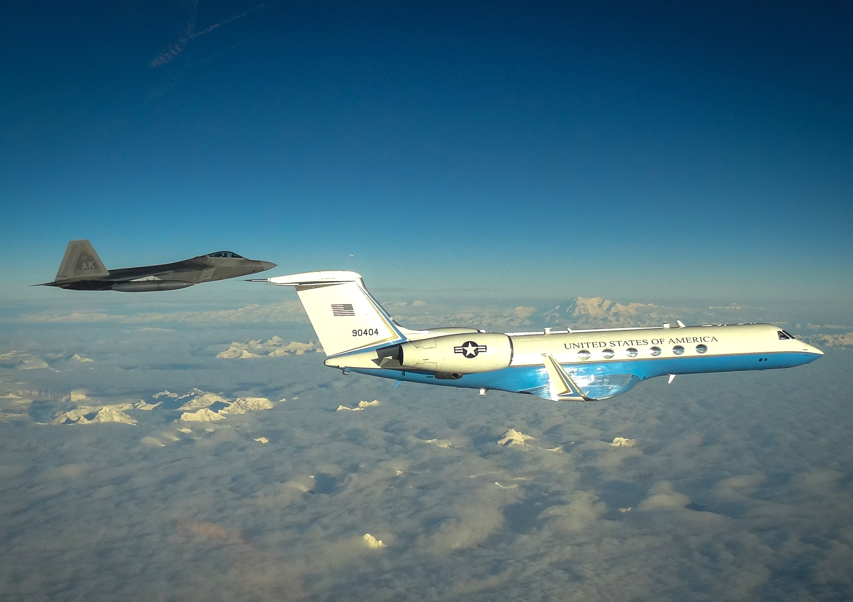
My bio
My background
  U.S. Air Force Academy—English Degree
  Northern Arizona University—Master of Education
U.S. Air Force—20 years
  Pilot Training—Laughlin AFB, Texas
  VIP Evaluator and Instructor Pilot—C-21
    Stuttgart Army Airfield, Germany and Keesler AFB, Mississippi
  Transport Instructor Pilot—C-17
    Charleston AFB, South Carolina
  Military History and Leadership Instructor/Staff Officer
    Maxwell AFB, Alabama
  Special Air Missions VIP Evaluator and Instructor Pilot—C-20 and C-37
    Andrews AFB, Maryland
Commercial Airline Pilot
  Boeing 737 First Officer
7,000 flight hours

Slide 4
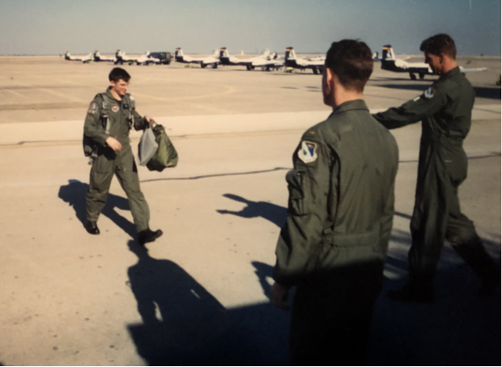
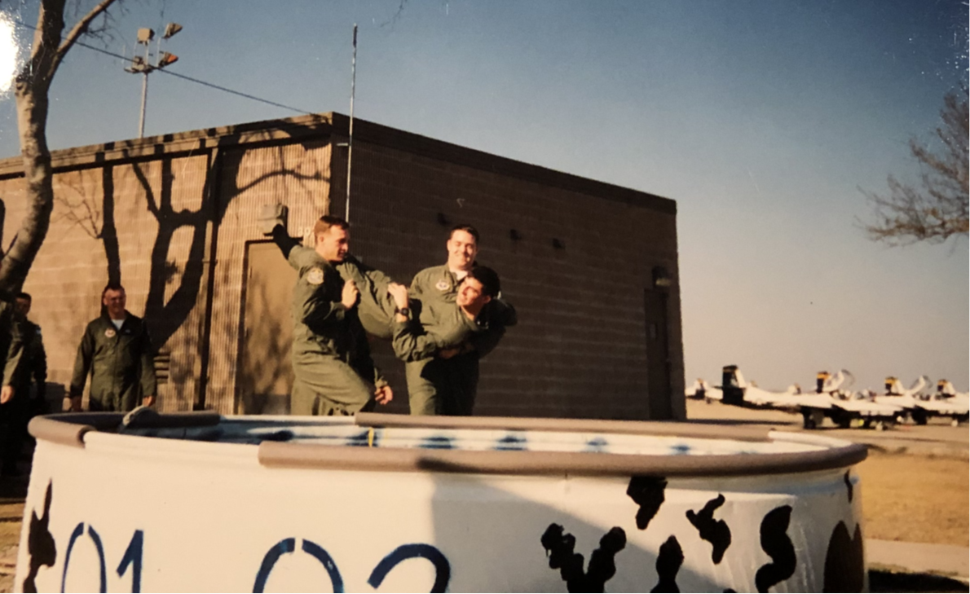
My bio…

Slide 5
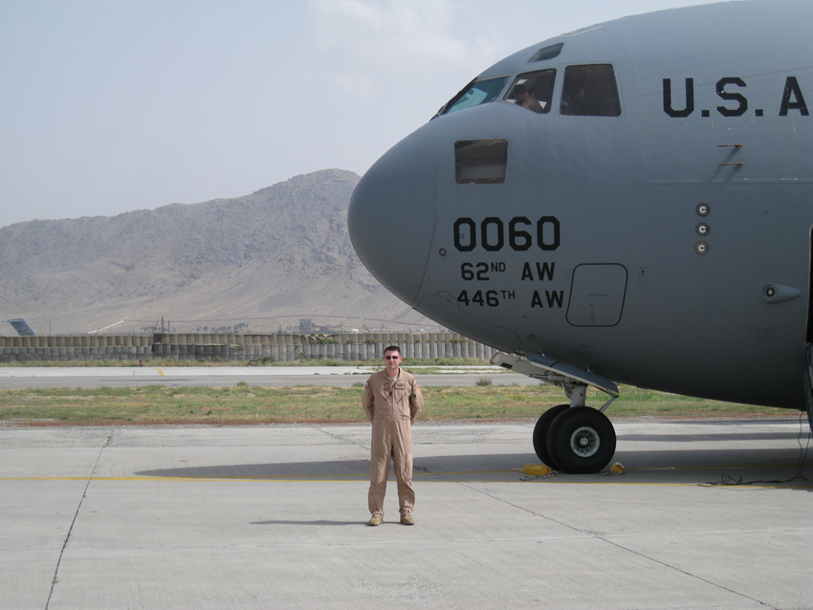
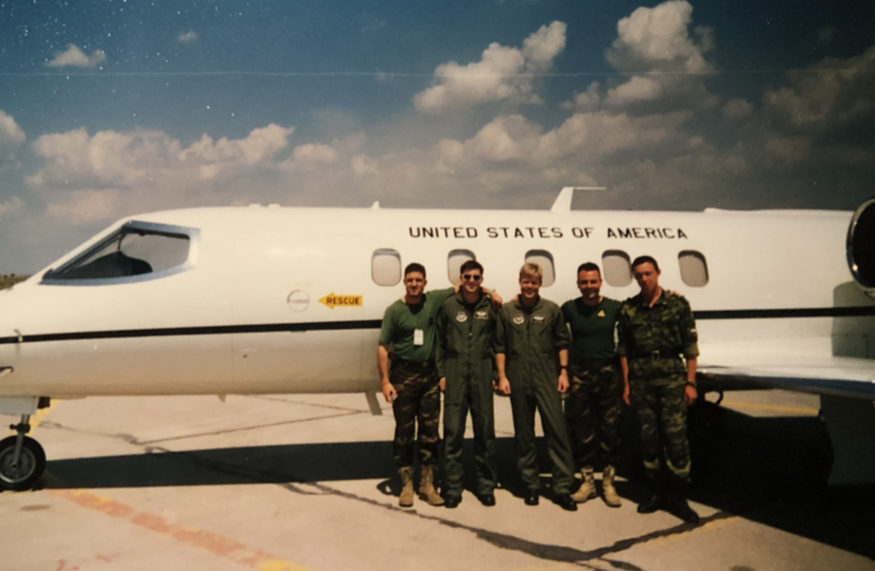
My bio…

Slide 6
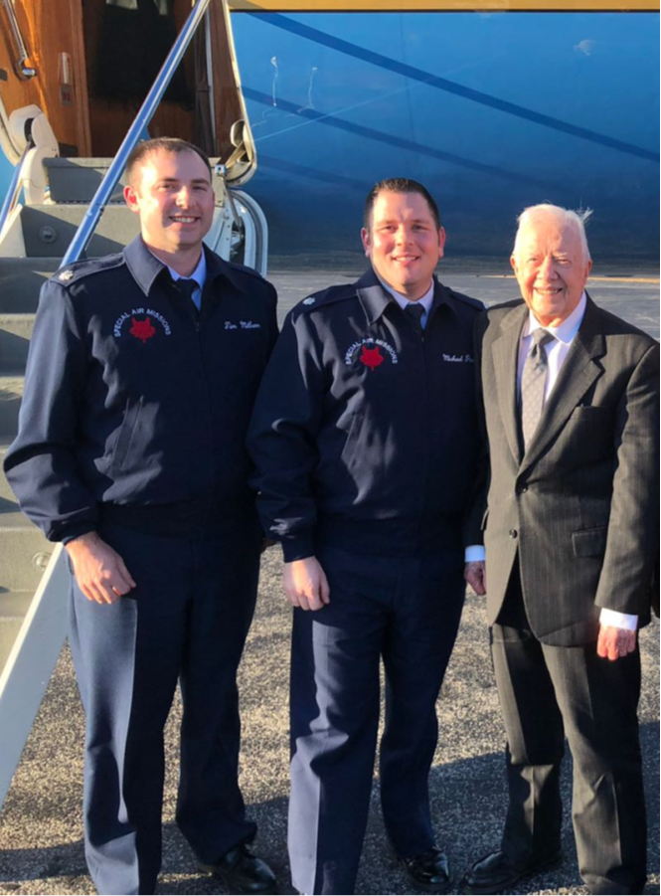
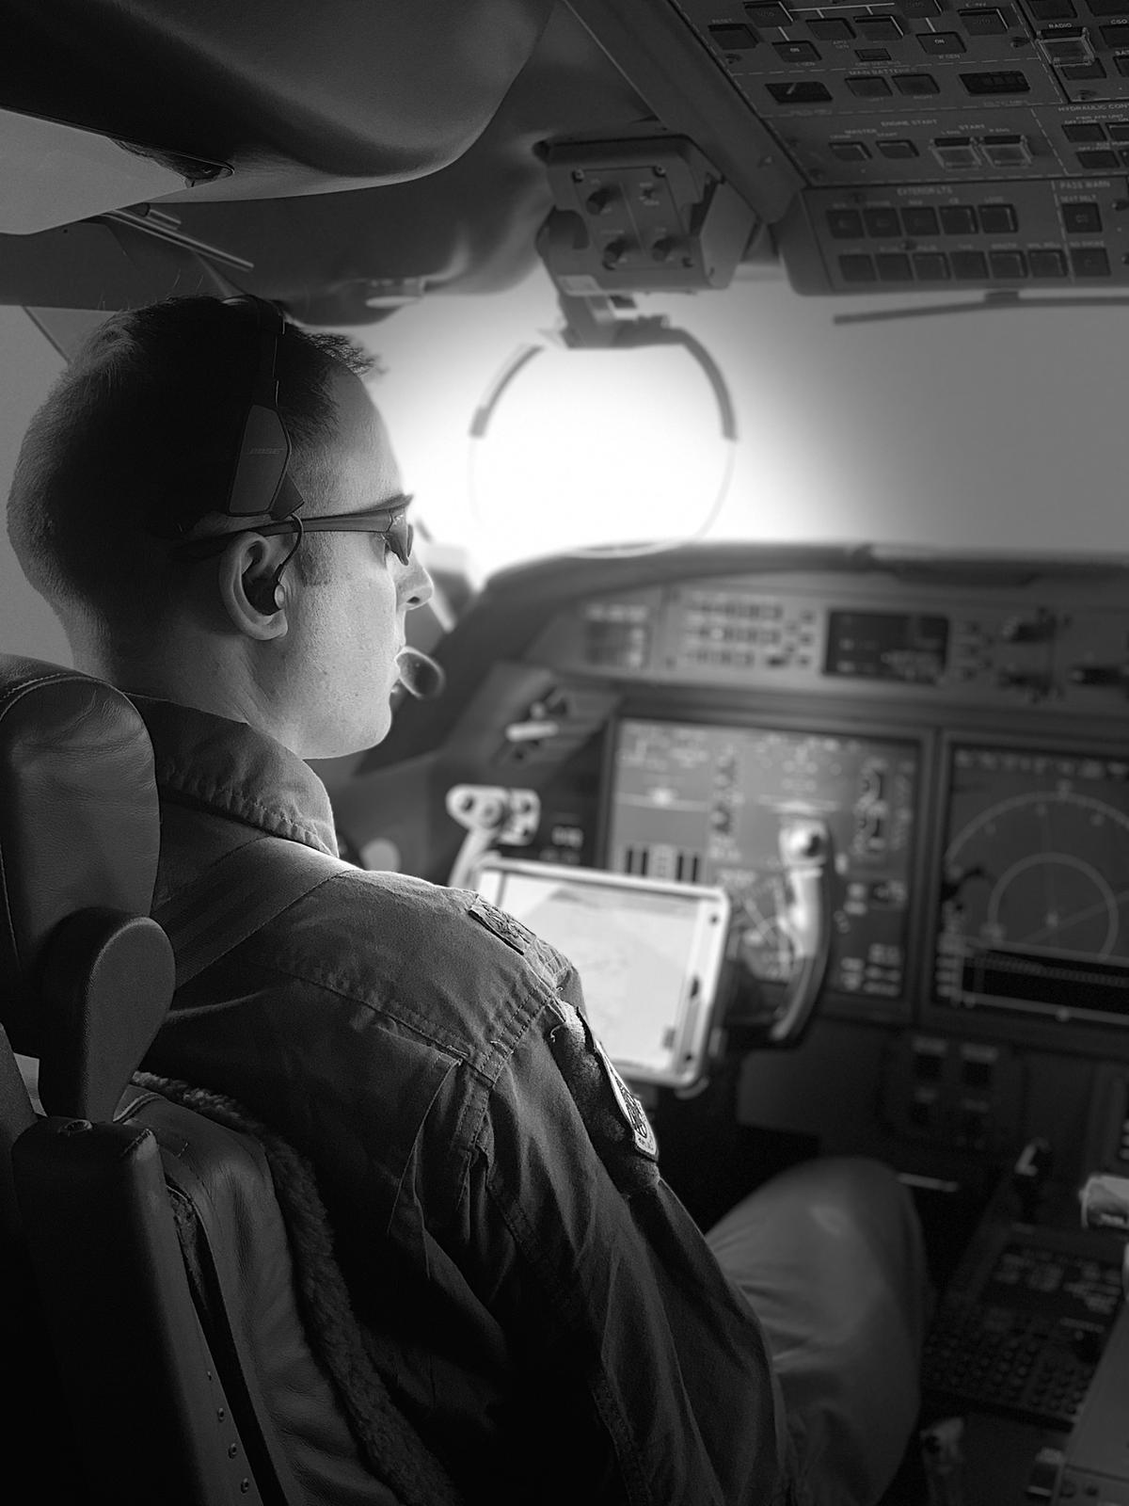
My bio…

Slide 7
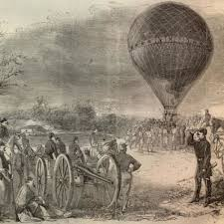
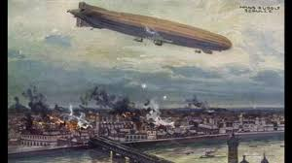
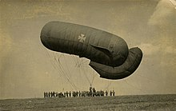
Early lighter than air uses
  Balloons
    Napoleon, American Civil War
  Airships
    Long range bombing

Slide 8
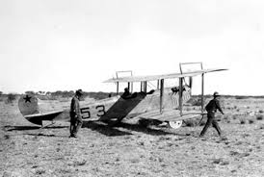
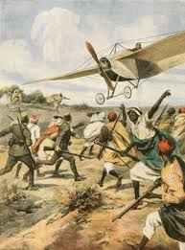
Heavier than air flight and early thoughts on airpower
  Wright brothers
    U.S. Army requirement
  Limited bombing and attack role
    Italy
  “Air forces” at beginning of World War One were small and generally not combat ready
U.S. Army Curtiss airplane in Mexico-1916
Italian airplane attacking Ottoman troops; Libya 1911

Slide 9
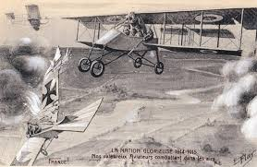
World War One
  Initially used for observation
    Aircraft considered too small to carry significant weapons
      UK—”too dangerous” to arm an aircraft
  Airmen began devising ways to protect their aircraft from the enemy
    Airspace denial
    First air to air victory with a machine gun
    Synchronized machine gun

Slide 10
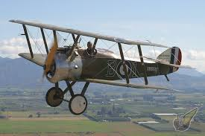
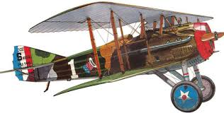

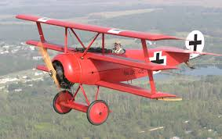
Observation generally considered the most critical role of the airplane
  The fighter plane was used to protect/defend from other aircraft

Slide 11
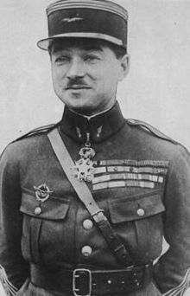
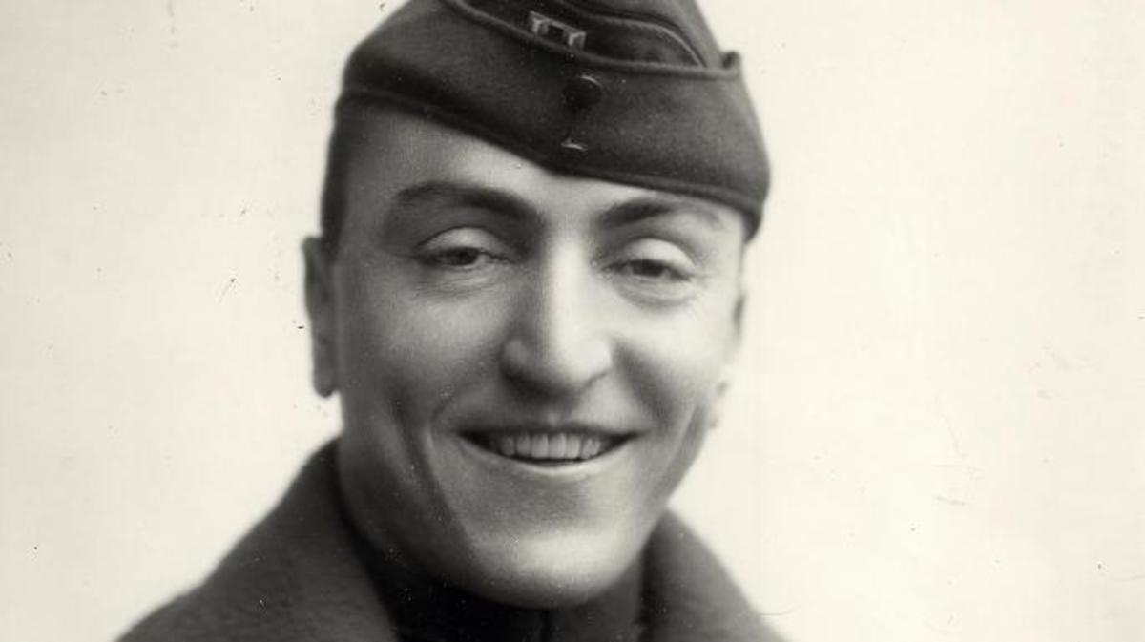
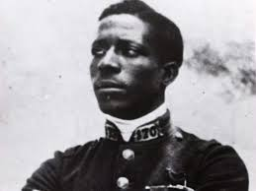
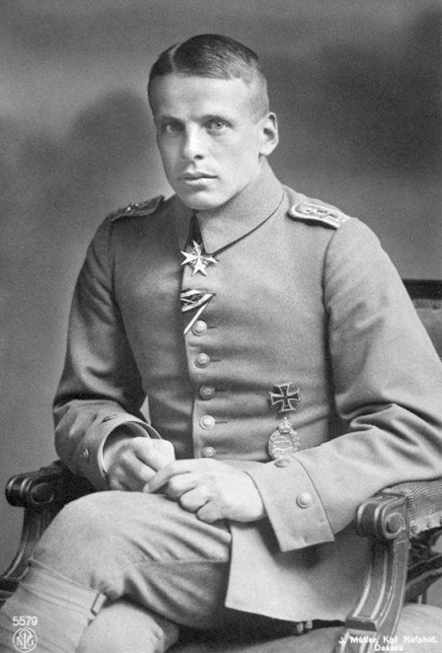
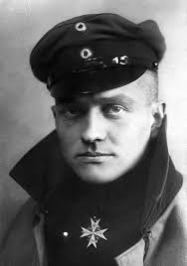
Notable World War One airmen
Eddie Rickenbacker (USA)-26
Rene Fonck (France)-75
Eugene Bullard (USA/France)-2?
Oswald Boelcke
(Germany)-40
Manfred von Richtofen (Germany)-80

Slide 12
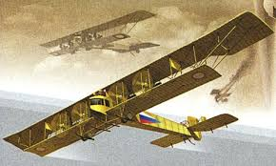
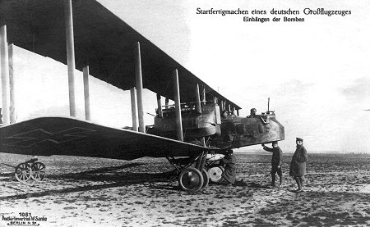
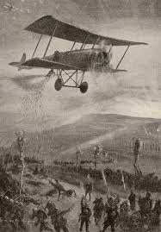
Other important uses of aircraft
  Bombers
  Ground attack
  Limited transport

Slide 13
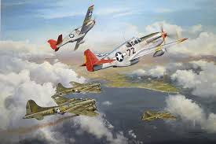
Impact through today
  By the end of World War One, airplanes were flying most of the types of missions that were used later and today
World War One highlighted need for independent Air Force
  Royal Air Force-1918
  Luftwaffe-1935
  U.S. Air Force-1947
  U.S. Space Force-2019

Slide 14
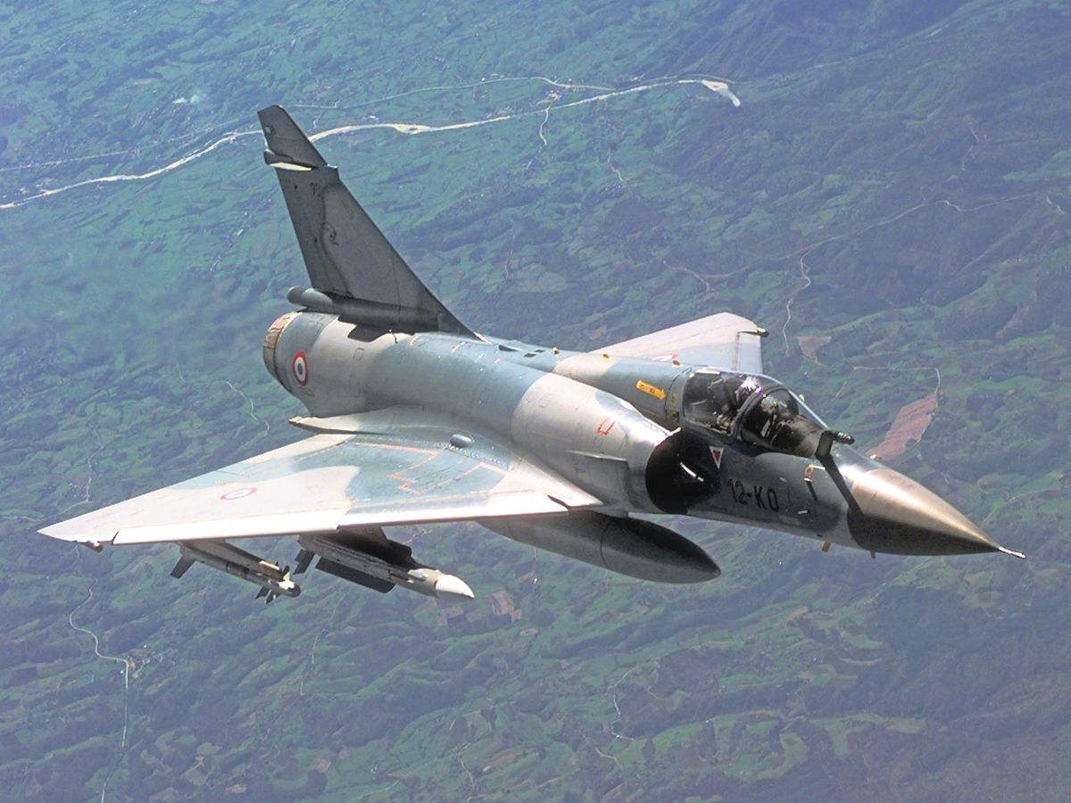
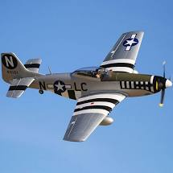
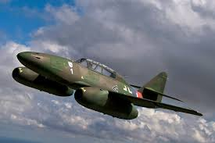
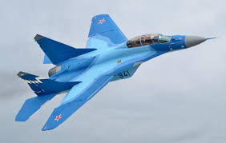
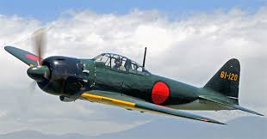
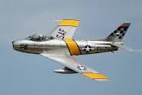
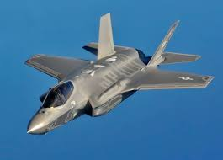
Evolution of the aircraft and technology
  Fighter and attack

Slide 15
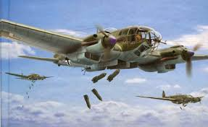
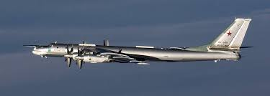
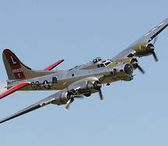
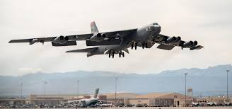
Evolution of the aircraft and technology
  Bombers

Slide 16
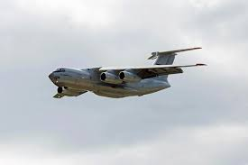
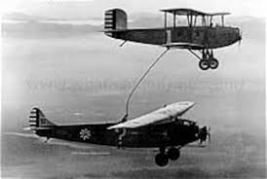
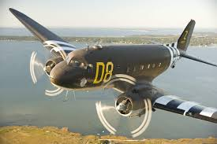
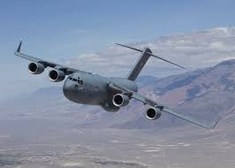
Evolution of the aircraft and technology
  Transport and refueling

Slide 17
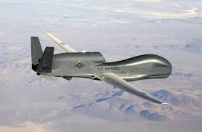
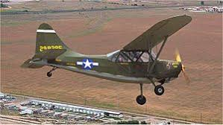
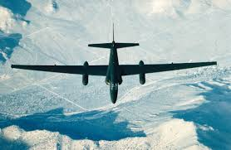
Evolution of the aircraft and technology
  Reconnaissance

Slide 18
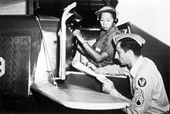
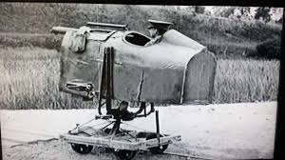
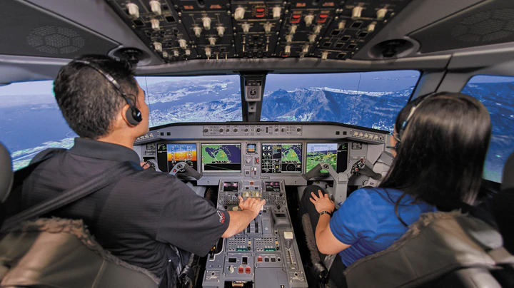
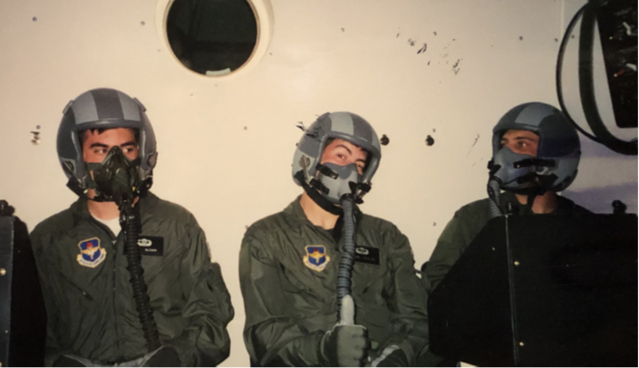
Evolution of the airman
  Training and role as an operator

Slide 19
FUTURE?

