Slide 1
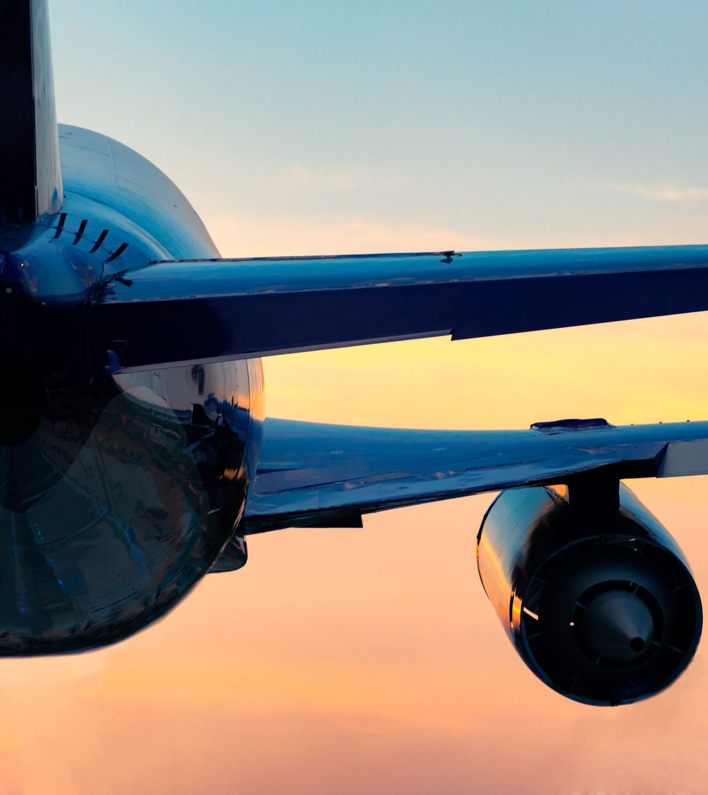
Becoming and Working as an Airline Pilot
Tim M.
BOEING 737 FIRST OFFICER, SOUTHWEST AIRLINES

Slide 2
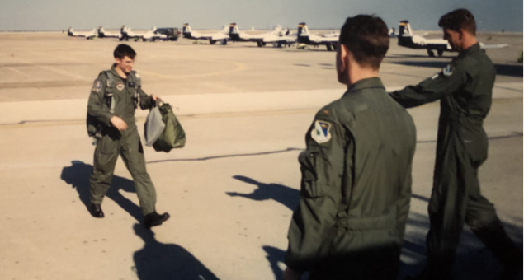
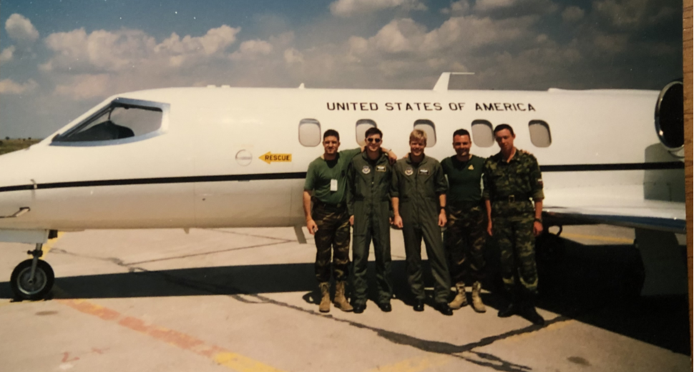
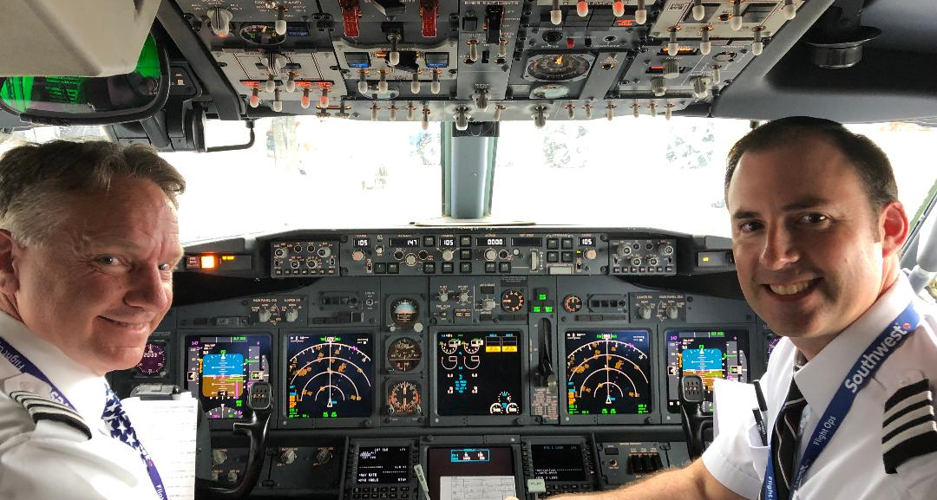
A little about me
My education
  The Gilbert School
  U.S. Air Force Academy—English Degree
  Northern Arizona University—Master of Education
U.S. Air Force—20 years
  Pilot Training—Del Rio, Texas
  VIP Evaluator and Instructor Pilot—Learjet 35
    Stuttgart, Germany and Biloxi, Mississippi
  Transport Aircraft Instructor Pilot—C-17
    Charleston, South Carolina
  Military History and Leadership Instructor/Staff Officer
    Montgomery, Alabama
  Special Air Missions VIP Evaluator and Instructor Pilot—Gulfstream 3/5/550
    Andrews Air Force Base, Maryland
Commercial Airline Pilot
  Boeing 737 First Officer
7,000+ flight hours; over 90 countries visited
  49 of 50 states visited (sorry South Dakota)

Slide 3
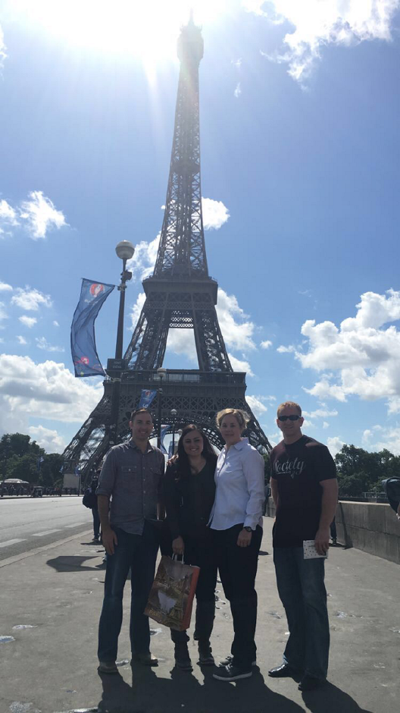


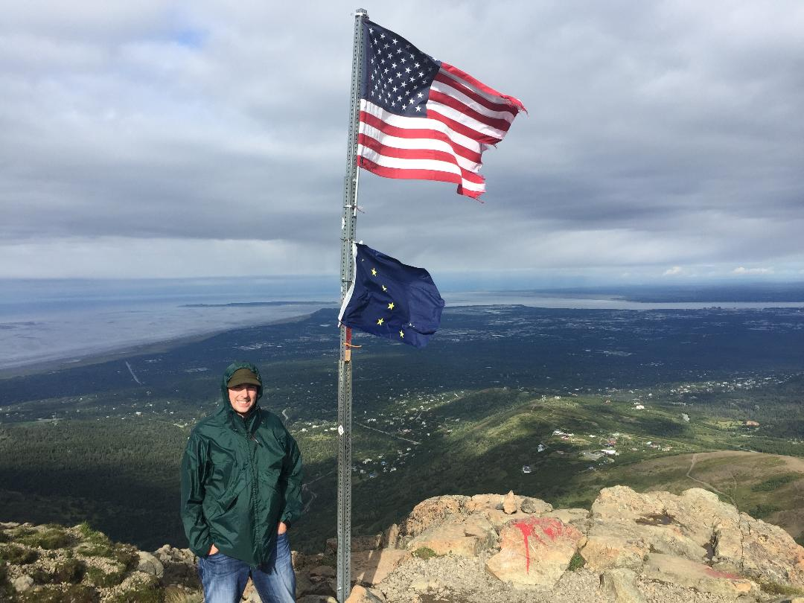
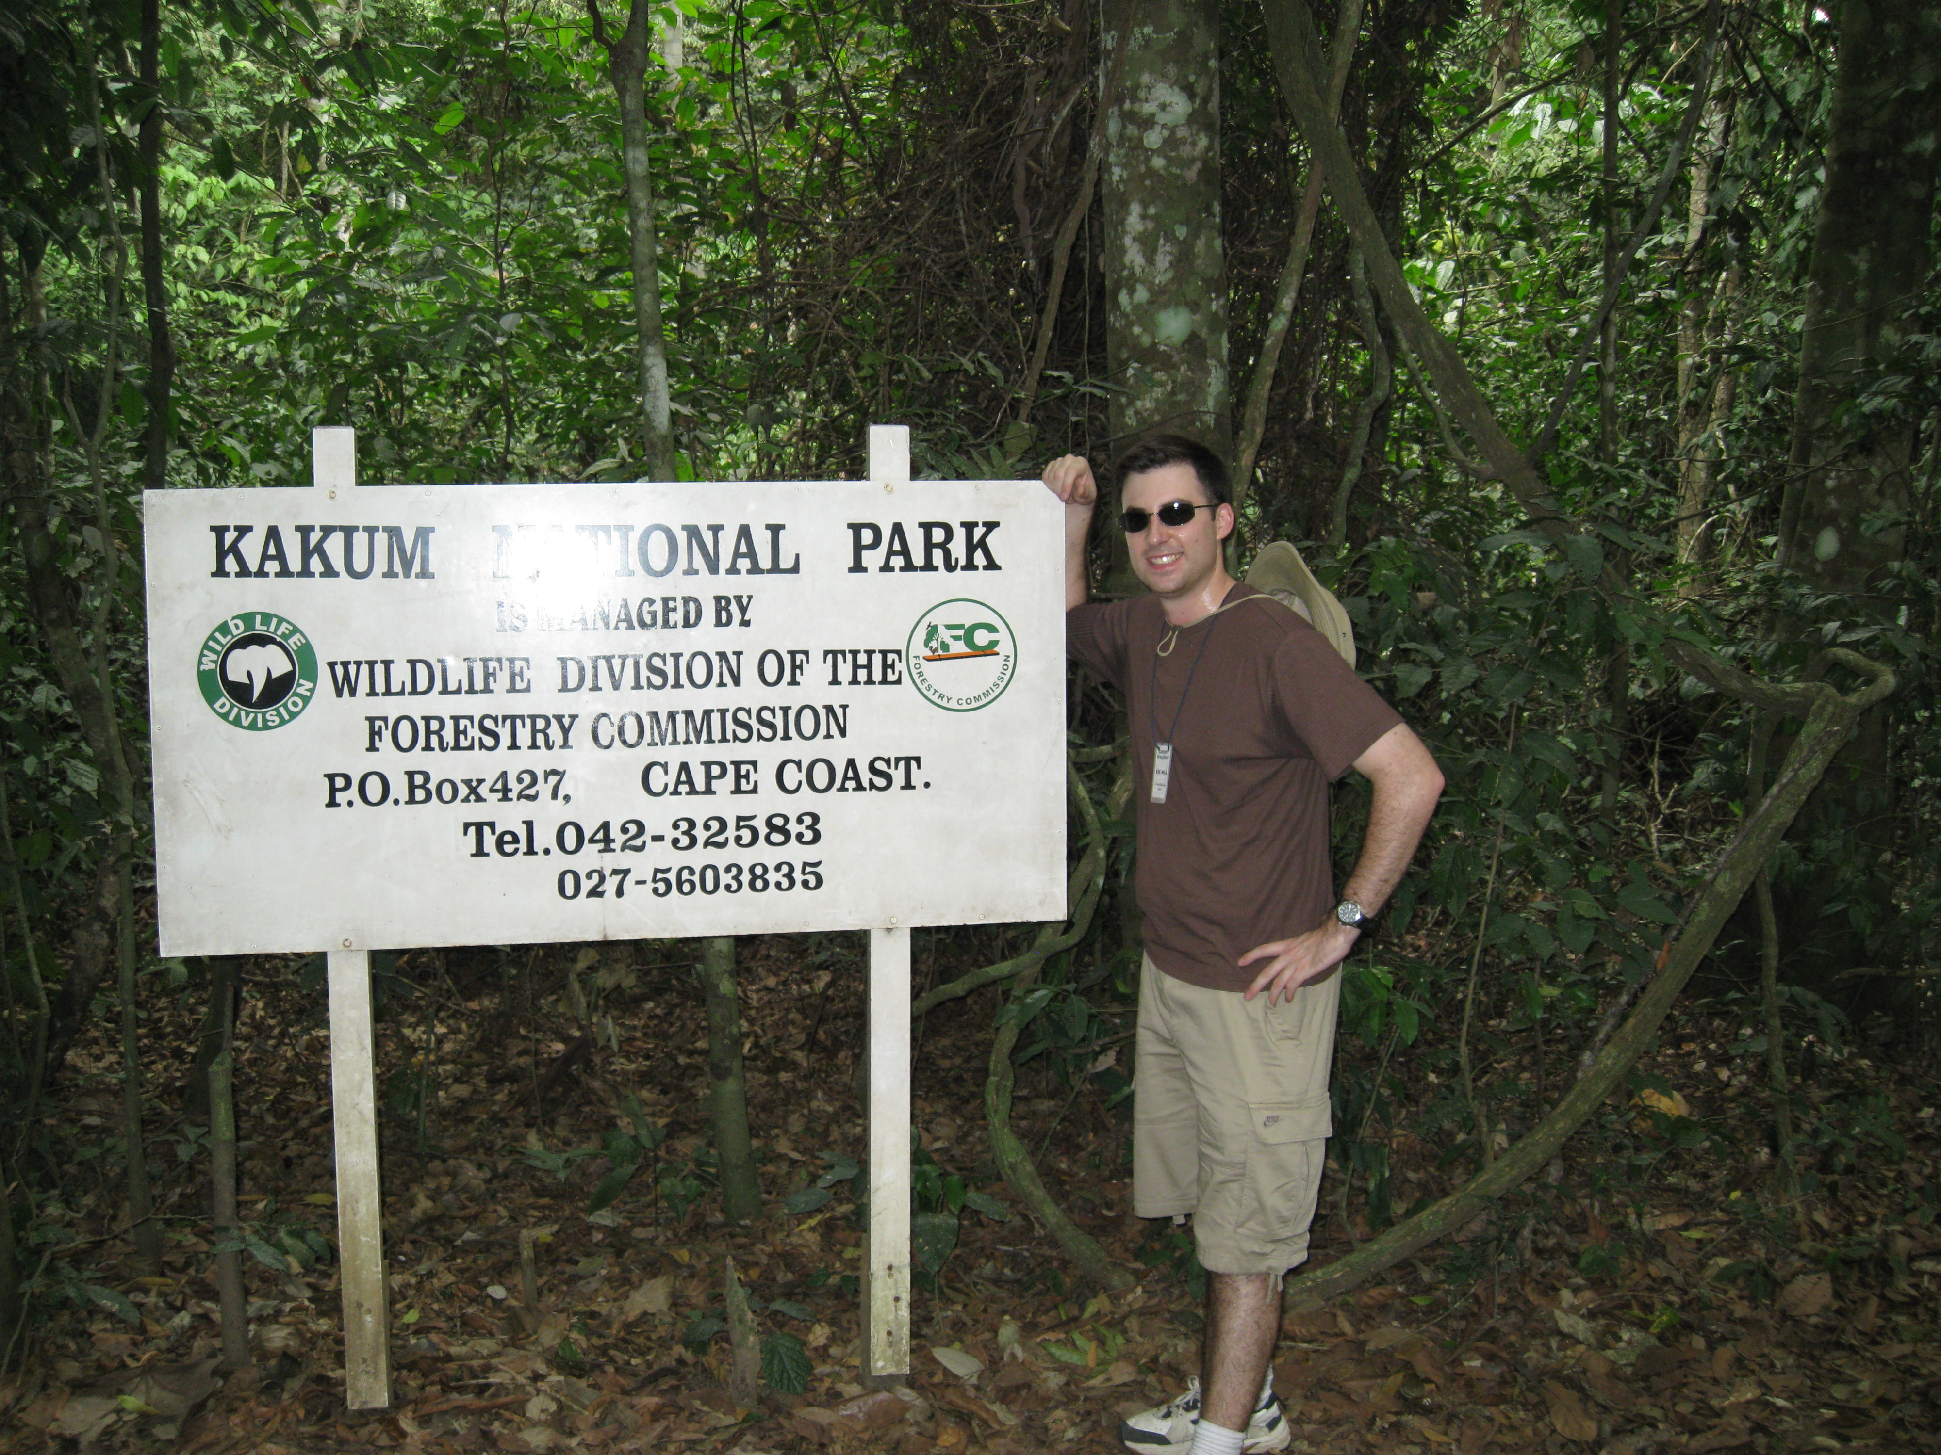
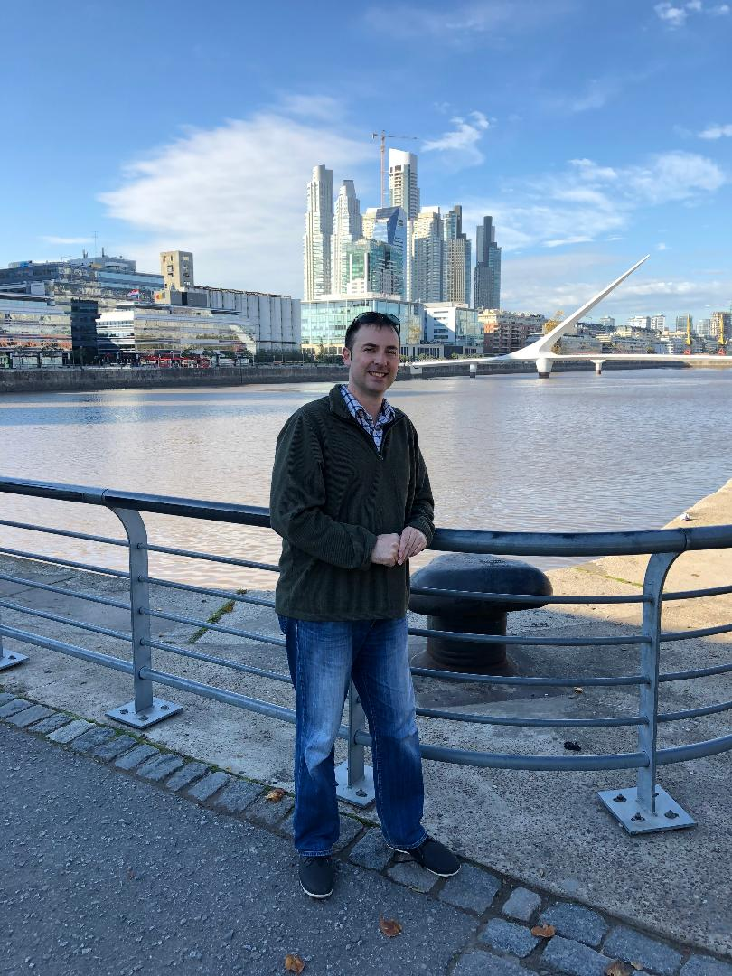
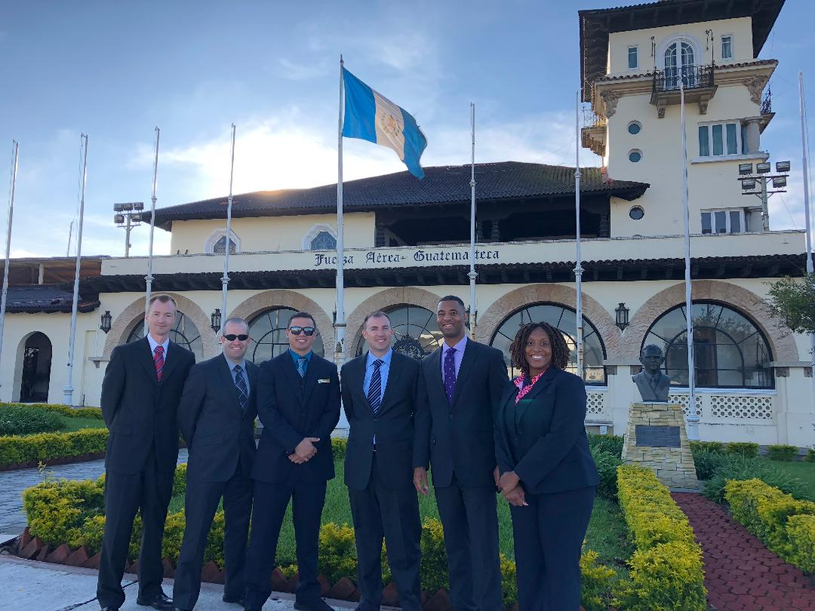
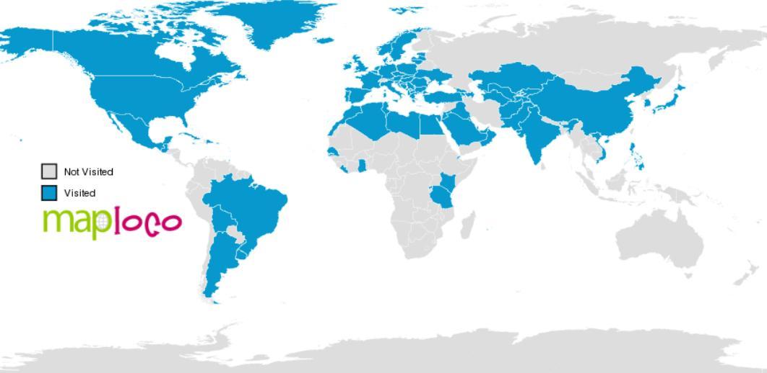
Do you like to travel? These are just a few of the places I’ve been
Anchorage, Alaska
North America
Great Wall of China
Asia
Republic of Korea
Asia
Paris, France
Europe
Ghana
Africa
Argentina
South America
Guatemala
Central America

Slide 4
What is required to be an airline pilot in the United States?
You must:
Be at least 23 years old
Have a passport for international travel
Earn an Airline Transport Pilot Certificate for multi-engine aircraft
  1500 flight hours minimum
  Be proficient in the English language
Pass Flight Physical
  You have to go to the doctor once a year
  If you’re over 40 years old, you have to go twice a year
Pass a drug test
Most airlines in the U.S. have other requirements, too!
Earn a Bachelor’s (4 years) or higher college degree
2,500 flight hours to include time as Captain
Have a “Radio Station” license
Show leadership positions and qualifications in past jobs
Have a friend or friends who worked with you recommend you to that airline

Slide 5
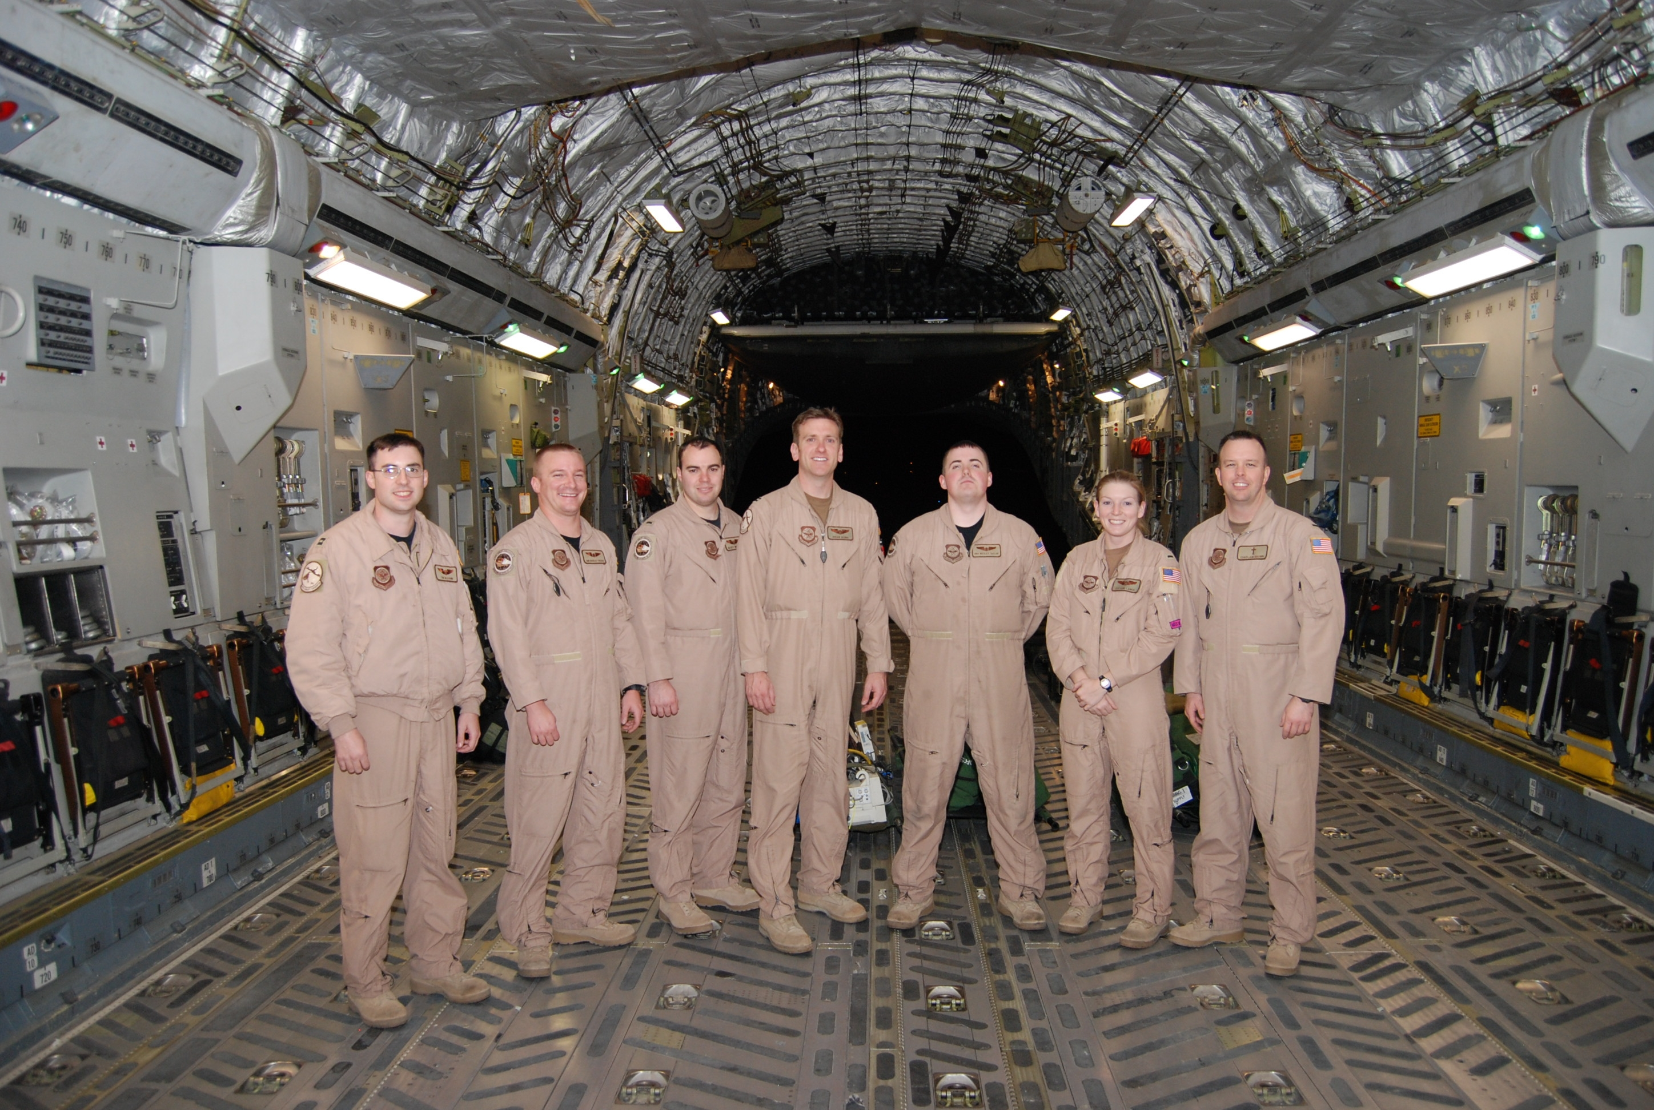
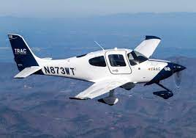
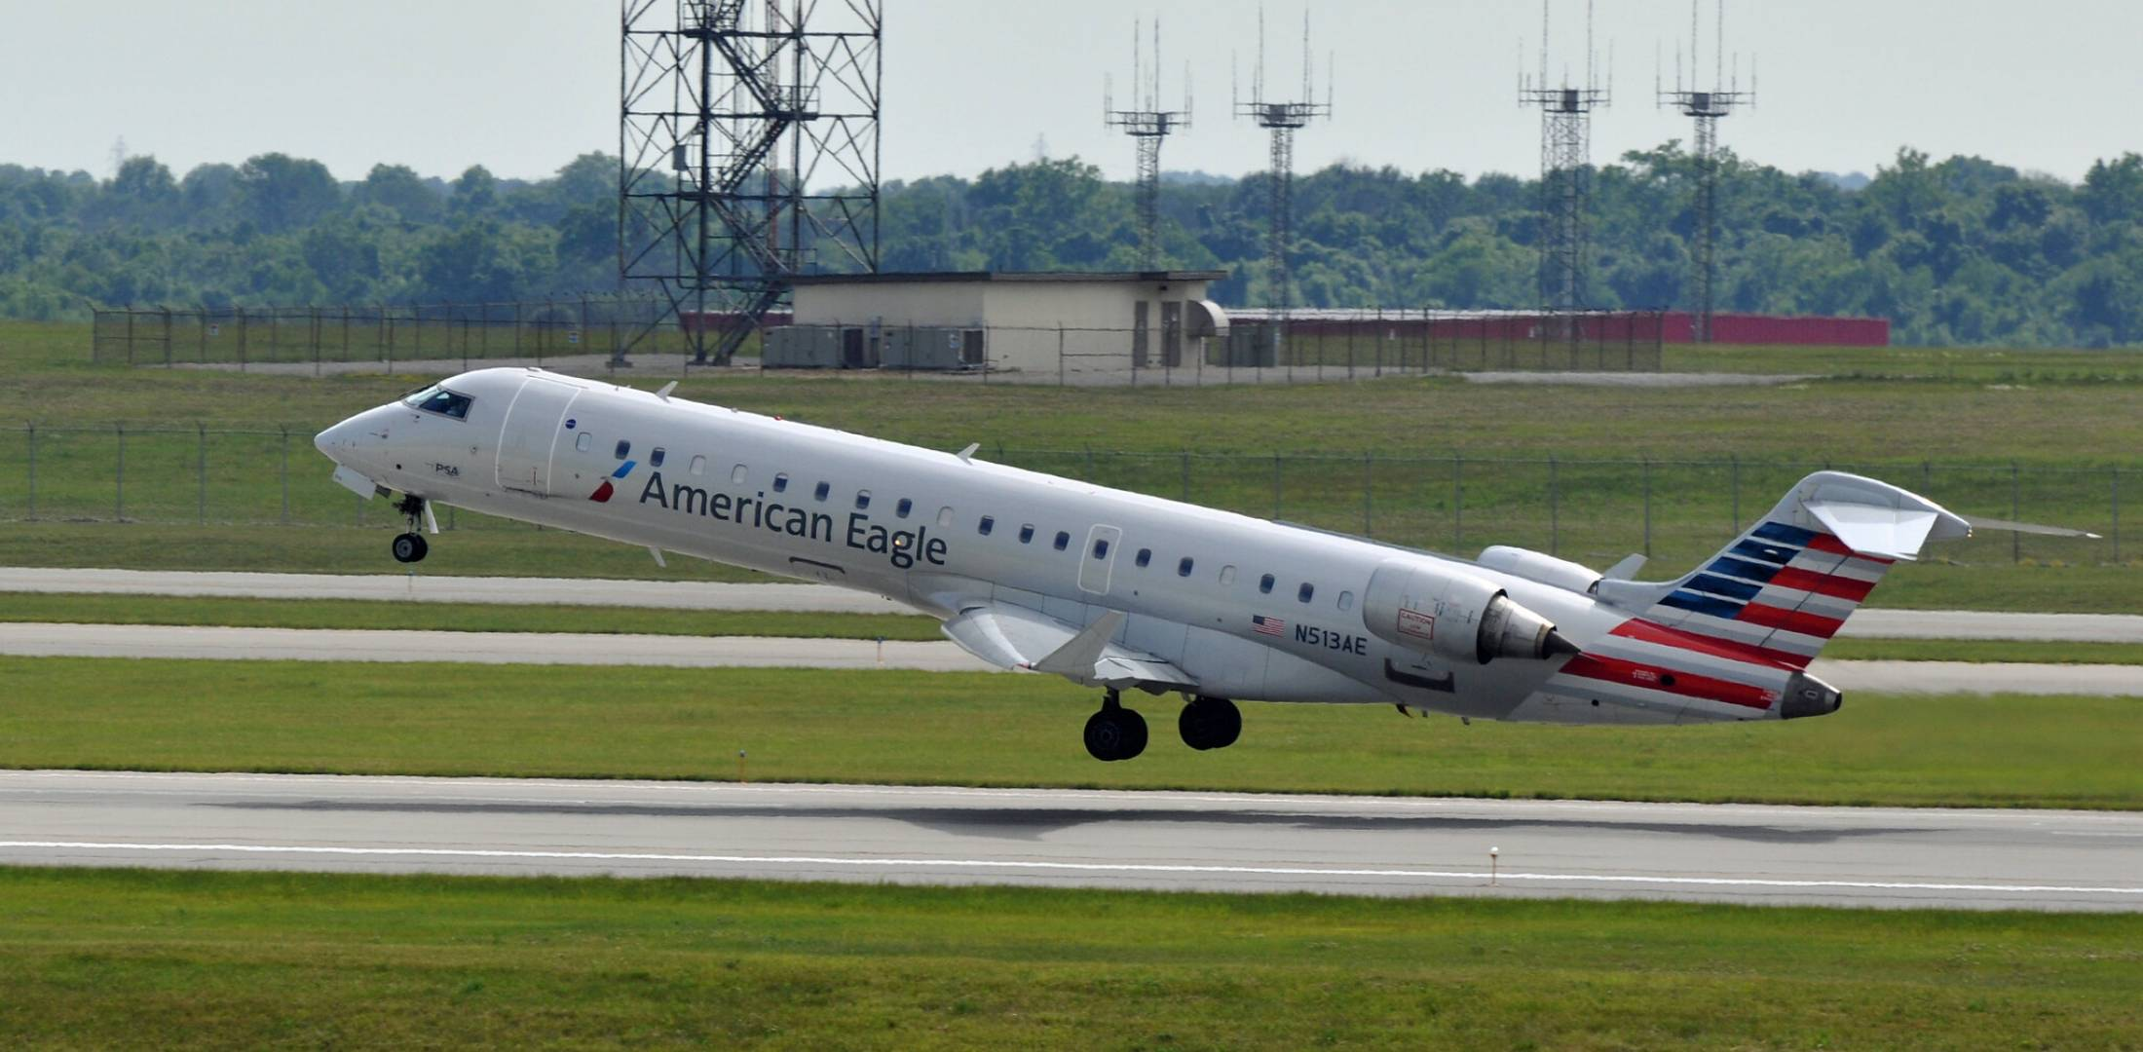
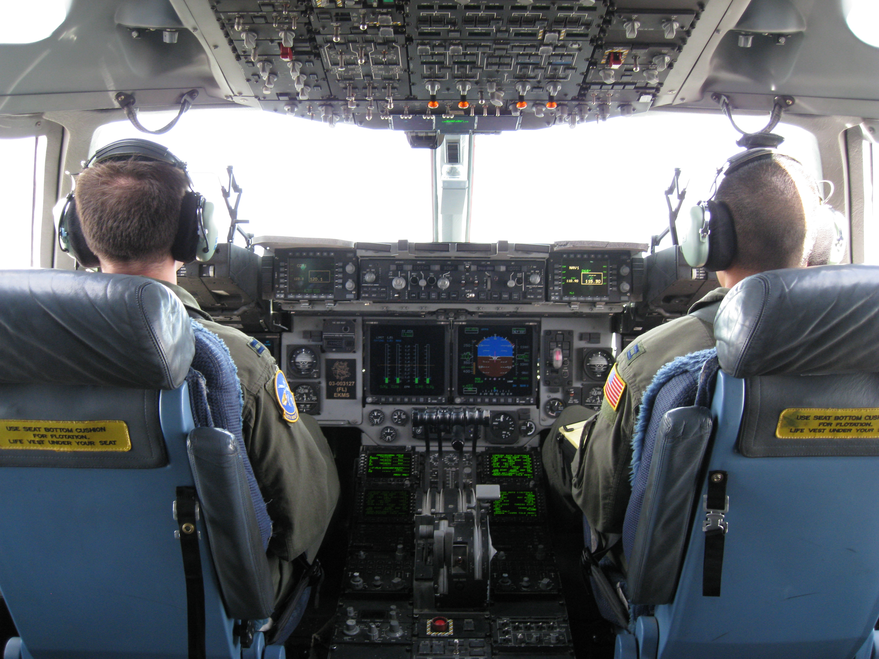
Two Most Common Career Paths
“Military Path”
“Civilian Path”
Neither of these paths are easy! You need to work hard, maintain good physical/mental health, and continue to work on upgrading (e.g. first officer promoted to captain) in each of your positions.

Slide 6
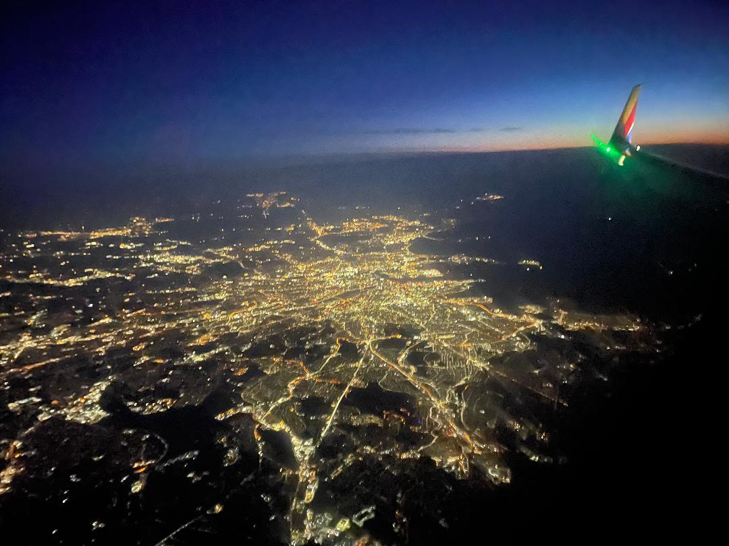
Pros and Cons of this career
Pros
YOU GET TO FLY AIRPLANES!
Travel
Pay and benefits are excellent
Family is extended travel benefits
  Fly anywhere for free or very inexpensive
Your time off is your time off
You can live almost anywhere you want
Typically have multiple days off between flights to pursue other interests
MY OFFICE HAS THE BEST VIEWS IN THE WORLD
  Just don’t count my classmate Raja and his friends on the Space Station!
Cons
Time away from family
Sometimes you’re looking for other work!
  More unemployment in the country means less people traveling; therefore, need for less airline pilots
“Seniority-based” system
  You should expect to fly weekends and holidays, possibly for a few years or more
Job is physically, emotionally, and mentally demanding and tiring
Family travel is “space available”
Commuting and deadheading (I’ll explain what that means)
Airport food
1 year “probationary” period
Airlines are very strict on how you dress and look

Slide 7

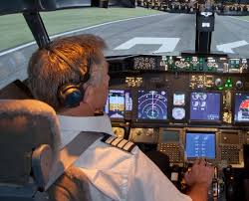
I have all that, now what?
Airlines have an interview, and it can last up to three days!
May start with an online video interview or telephone call
In person interview will focus on your:
  Flying skills
  Judgment
  Communication
  How you handle stress
  Teamwork
  Personality
  Simulator exercise
You can be asked about volunteer work related to aviation or your local community
They will do a background check

Slide 8
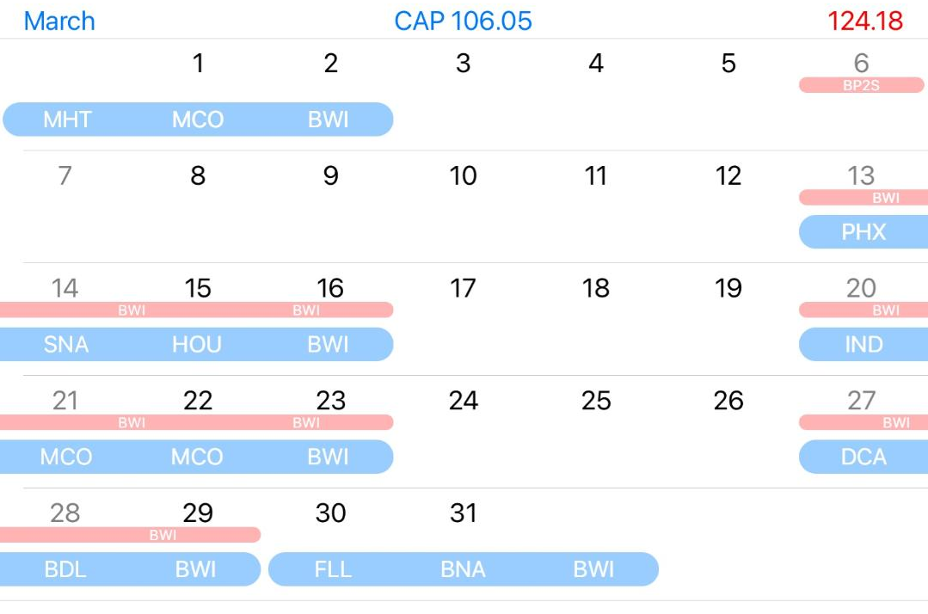
What does my typical month look like?
A typical month:

Slide 9
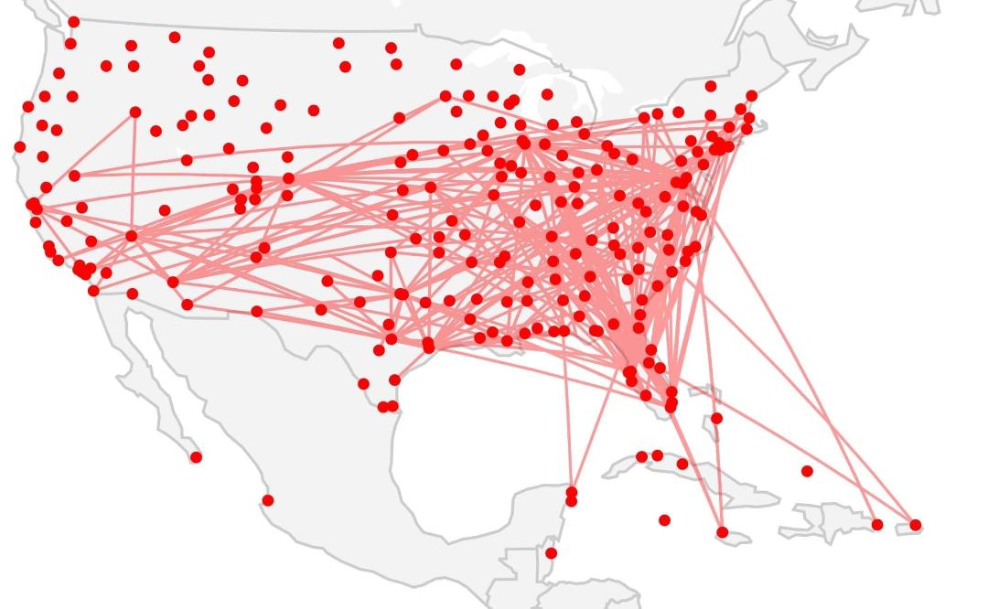
What does a year look like?
My 2021 flights:
Also included during the year:
Annual checkride (4 days classroom and simulator)
Training every 3 months online
FAA Flight Physical
Line checks from FAA or Company Check Airmen
Other training
This is 780 hours in flight. That’s almost 33 days in the air!

Slide 10
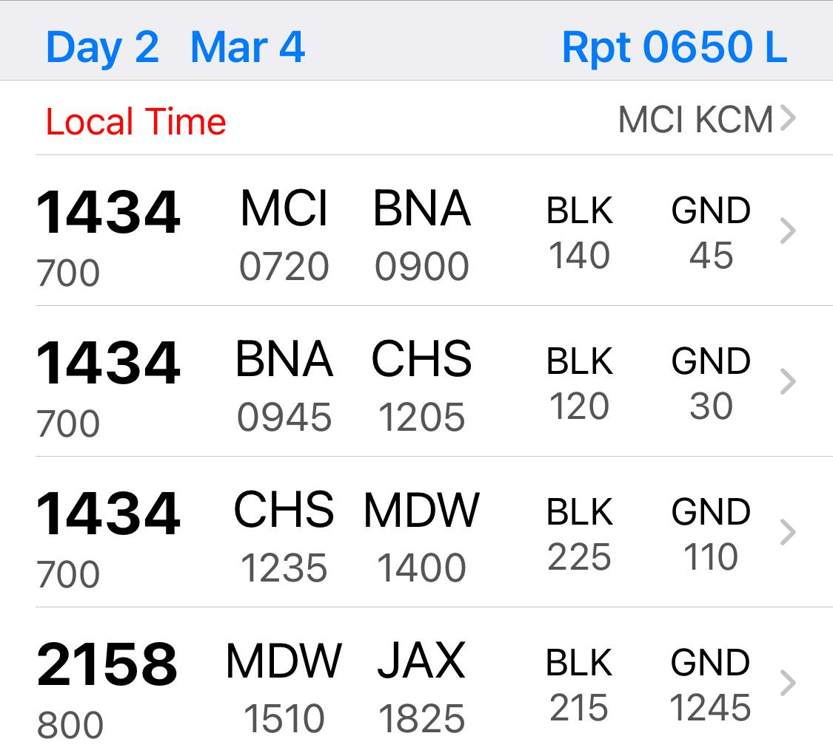
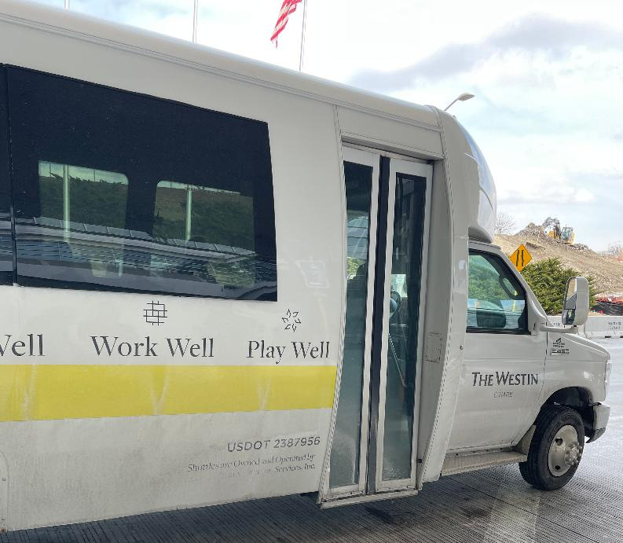
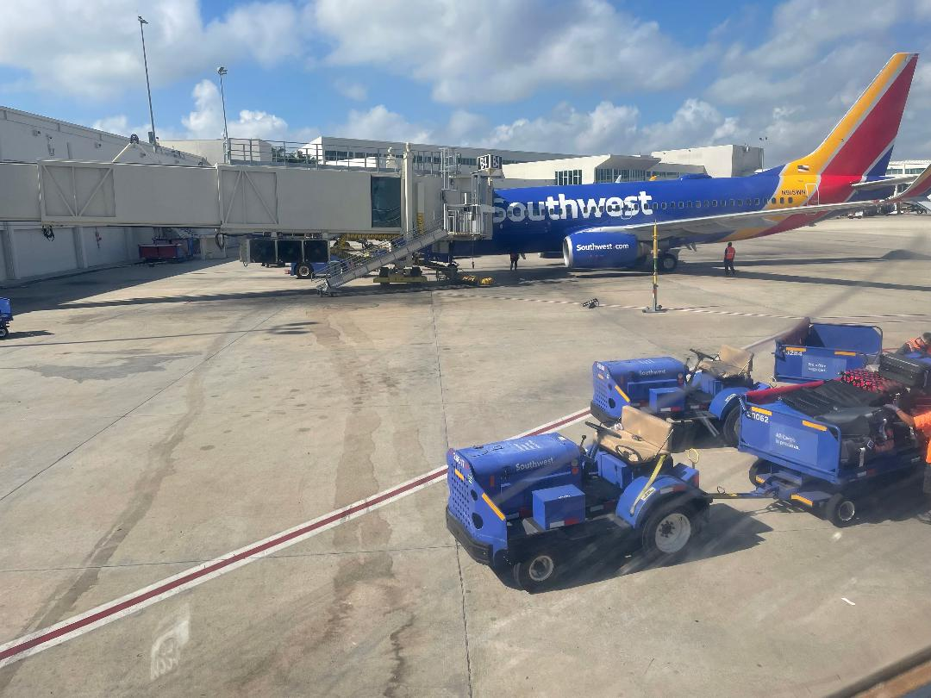
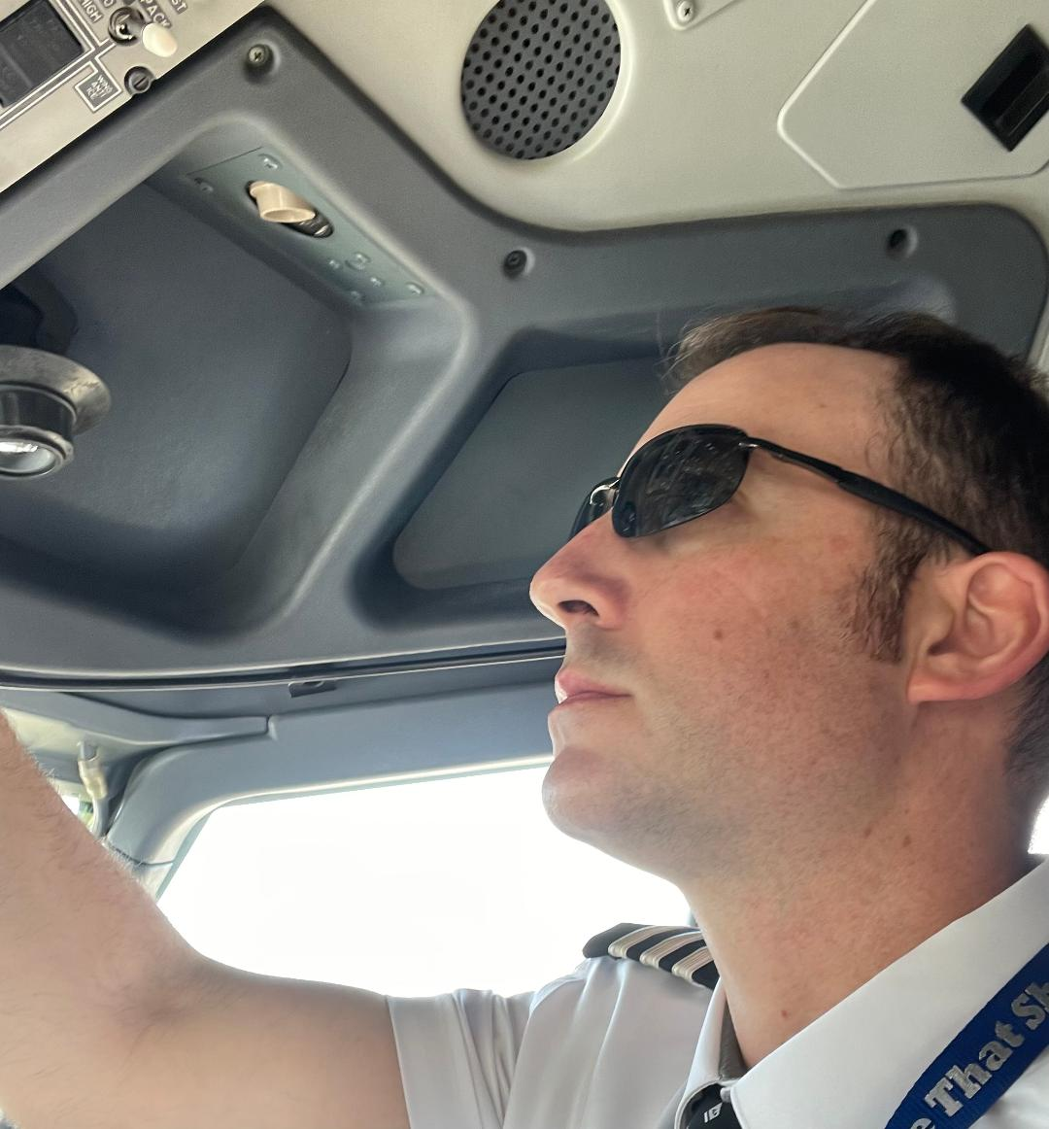
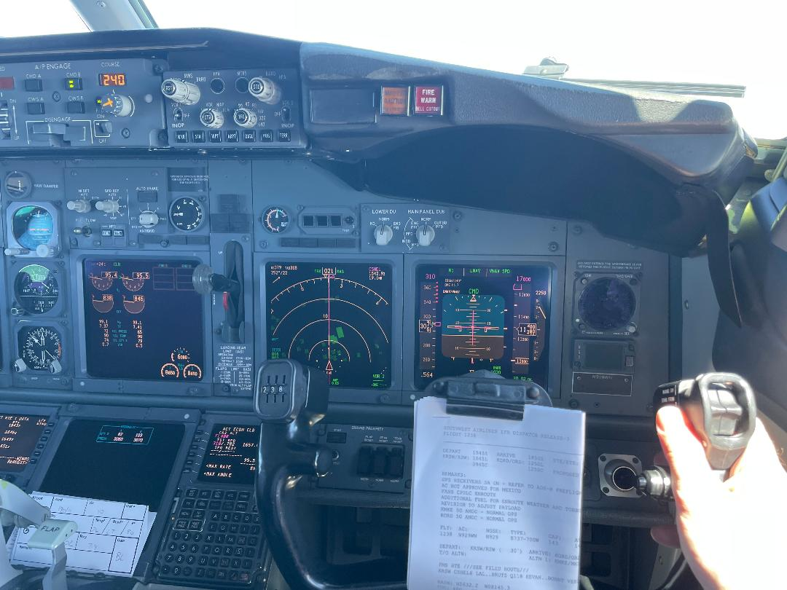
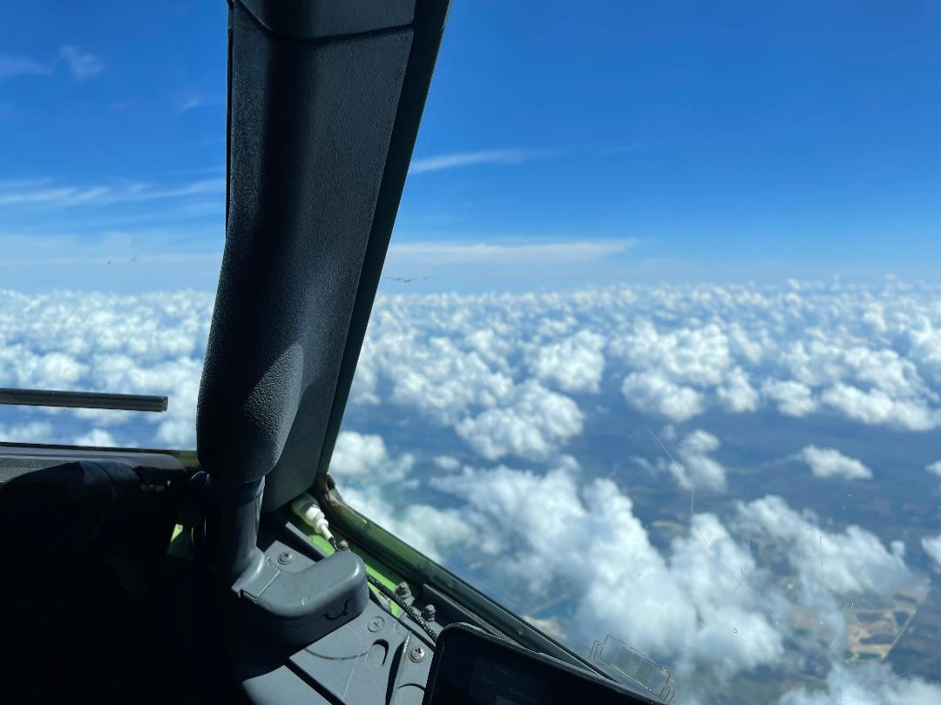
So, what does my typical workday look like?
A typical day for me:
4:50 AM: wake up and exercise
5:50 AM: eat breakfast, shower, get ready and get on crew van
6:30 AM: arrive at airport, go through security
6:45 AM: arrive at airplane and begin pre-flight
6:50 AM: passengers start getting on
7:15 AM: push back from gate and fly
8:45 AM: land in next city. Spend some time in the airport, get something to eat and prepare airplane for next flight.
Do this three more times!
6:10 PM: land for last time in day. Shutdown airplane.
6:30 PM: leave airport
7:00 PM: arrive at hotel, eat, iron my uniform for the next day. Call home.
8:00 PM: go to sleep and get ready for the next day

Slide 11
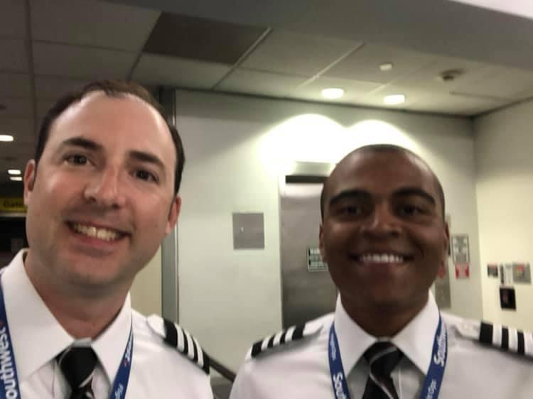
Questions?
First Officer Tim M.
https://firstofficertim.com
First day of IOE (Initial Operating Experience)! June 2019

Slide 12
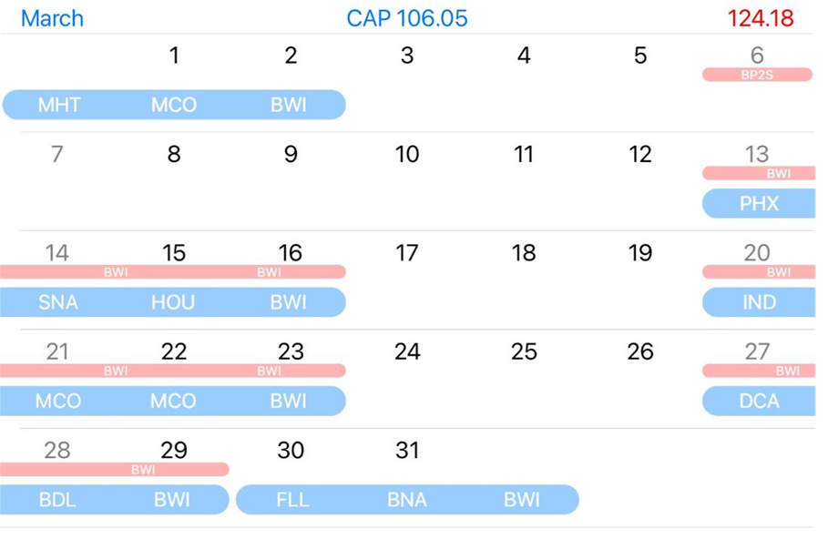
Reserve period: Pilot has 2 hours to report to airport
Reserve period where flying was assigned (blue line under red line)
Flying block: pilot is flying these days. 3 letter code is overnight city (e.g.-PHX is Phoenix, AZ

Slide 13
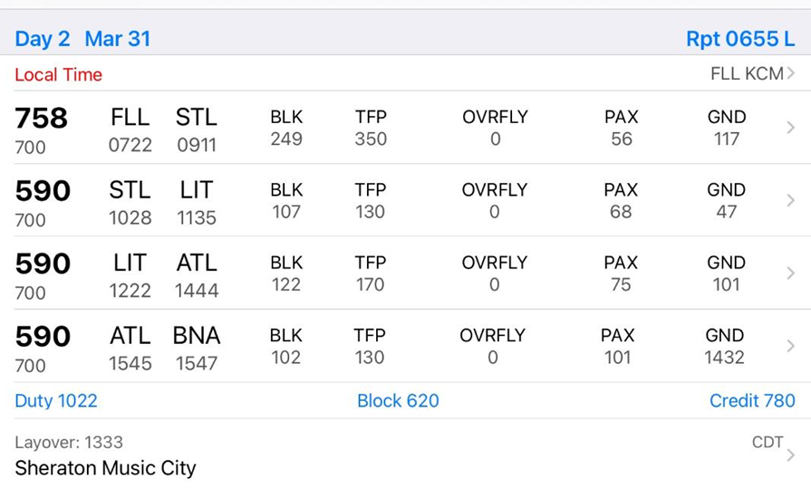
Cities flown to (FLL STL means Ft Lauderdale to St Louis)
Flight number
Report time at gate
Ground time between flights (101 is 1:01 or 1 hour and 1 minute)
Aircraft type (700 is 737-700
800 is 737-800)
Length of workday
(1022 means 10 hours
and 22 minutes)
Block time (door closed to door open)
Number of passengers

